Slide 1

Learning to Adapt: Monitoring Design and Data Analysis for Adaptive Management
Lindsay Mico CEP, GISP
Bright Eye Analytics
SER 2016

Slide 2
Agenda
Intro 1:00 – 1:30
Fetcho 1:30 – 2:00
Design 2:00 – 3:00
Analysis 3:00 – 4:00
Q&A and/or project discussions 4:00 – 5:00

Slide 3
About me…
Jedi Knight
Master of Science
Data Nerd
Etc

Slide 4
Workshop Philosophy
I’m going to walk through the key stages I use in designing and analyzing a monitoring program from a very pragmatic statistical perspective.
By this I mean that although everything we discuss will be about generating quantitative results, there will be a minimum of discussion about math itself.
We can do this because of the technology tools available to us
With this approach we need to understand how and when to use something, but don’t need to know what goes under the hood.
We will not talk about specific field protocols except as examples

Slide 5
Monitoring Philosophy
Think deeply about what you need to know first
Add in what you want only after
If you can’t be confident in answering what you need to know, consider changing the question or skipping the project
Don’t monitor just because you have a budget – its really hard to back calculate from budget to question (not that its easy the other way)
Getting to the end of a monitoring project with no answers is VERY frustrating

Slide 6
(more) Monitoring Philosophy
Translate the questions that motivate the monitoring into a quantifiable variables
Identify a good protocol for generating estimates of those variables
Focus on sources of error estimates in the protocol when selecting
Consideration of protocol error, resources, and quantified questions makes this an optimization problem.
Develop the key analytical steps before you collect the data
This includes writing the code that will QA and process the data

Slide 7
About the R programming language
R is an open sourced software package designed for statistical computing
Smarter people than us have built libraries for almost anything we can imagine
The R ‘ecosystem’ is awesome and is why I prefer it – Rstudio, Markdown, Rpubs, Shiny, and CRAN
It’s also a little bit ‘funky’ compared to other languages
Python is another EXCELLENT alternative that I use regularly (albeit for other purposes)

Slide 8
Introducing Ken Fetcho
Why did I invite Ken?
A monitoring funder needs to know….
The study design is appropriate to the question
The study design can be extended or aggregated in the future
The results are calculated accurately
The results can be reproduced
Additional analysis can be applied to the original data
This list also applies to a manager, property owner, regulator, or other stakeholder

Slide 9
Design

Slide 10
Design Section Goals
Decide what to measure.
Decide how much data to collect.
Incorporate temporal considerations in study design to maximize power and satisfy multiple objectives.
Build stratified, randomized spatial sampling plans with GRTS.
Select appropriate reference conditions.
Select appropriate protocols and sampling approach to leverage existing data.

Slide 11
First questions
Make a list of the specific questions that you want to answer, in order of importance.
Be clear what must be answered for the project to be a success
Make a realistic estimate of the resources available to do monitoring
Allocate resources to the questions, in order of importance, until they are exhausted
Be conservative in estimates of what can be accomplished
This is an iterative process and should be done with professional design expertise as part of the team

Slide 12
Types of monitoring (in order of complexity and not mutually exclusive)
Implementation - Did something happen? When and how?
Requires good geospatial data management
Status - What does something look like today?
Requires a one time spatially balanced sample design
Trend - How is something changing in space and time?
Requires a spatially balanced, multiyear sample design
Effectiveness - Did my project result in the physical changes I intended?
Requires a paired sample, multi year design
Did those physical changes effect the ecosystem in the way I intended?
Requires a paired sample, spatially balanced, multiyear sample design

Slide 13
Spatially balanced samples – why?
A spatially balanced sample helps us to accurately characterize a population that has substantial spatial auto-correlation
By balancing the sample spatially we maximize the chance that we get a representative sample for a given n
This is especially important because ecological monitoring can be very expensive on a per n basis
I.e. we work in a data poor environment
Note that the next few slides are drawn from a document Dr Tony Olsen prepared some time ago…

Slide 14
Spatially balanced samples – how?
GRTS – General Random Tessellation Stratified
Every replication of the sample ‘mimics’ the spatial balance of the resource in question
GRTS generates a hierarchical addressed grid, randomizes it, and then seeds a random start point before selecting sites in order.
Input for this is a GIS file that is then imported into R.
Most of the work is 1) theoretical (determining what your n is for each sub pop), and 2) GIS based to build your ‘sample frame’
A sample frame is the GIS file that defines what can be sampled

Slide 15
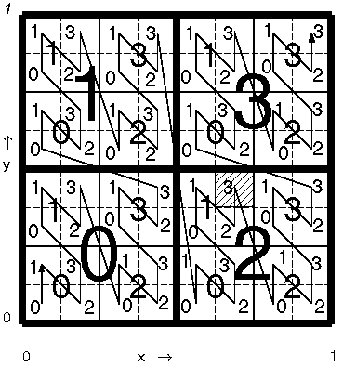
(more) spatially balanced random sampling
GRTS breaks a spatial area into a grid, numbers it, and then assigns semi-random numbers to each part of the grid (addresses it)
When all is said and done, you have a balanced sample where any contiguous sample remains random and balanced
More on Tony’s slides….

Slide 16
Selecting 16 Sample Points
1
2
3
4
5
6
7
8
9
10
11
12
13
14
15
16
Subdivide, Create Random Sequence, Assign Address & Colors
Sort Addresses
Random Starting point, Uniformly Sample Line
Assign Sequence Number to Each Point

Slide 17
Reverse Hierarchical Order
Original
Order
1
2
3
4
5
6
7
8
9
10
11
12
13
14
15
16
Base4
00
01
02
03
10
11
12
13
20
21
22
23
30
31
32
33
Reverse
Base4
00
10
20
30
01
11
21
31
02
12
22
32
03
13
23
33
Sort
00
01
02
03
10
11
12
13
20
21
22
23
30
31
32
33
RHO
Site
Number
1
2
3
4
5
6
7
8
9
10
11
12
13
14
15
16
Create Base4 Addresses
Reverse Address Digits
Sort
Assign RHO Site Nos.

Slide 18
Other cool things about GRTS
We can emphasize sub-populations in two ways –
We can require that the overall ‘n’ is allocated in a precise way (i.e. stratification)
We can also tweak the inclusion probabilities to get close to what we want, but still leave some randomness (I like this one better but both are ok)
Remember that any contiguous sample is random and balanced
Sites can be dropped, or the sample plan adjusted on the fly (by an expert only please!) so long as there is no bias and analysis takes it into account
You can add two GRTS samples together and they remain random and balanced (mostly)
Built for aquatic resources but good for any spatial sample

Slide 19
Sampling for trend
The simplest approach is to simply sample the restoration project across multiple years
But this doesn’t tell us if the change is due to restoration or other unrelated factors
So we add in a control, also sampled across time
But this doesn’t let us keep track of changes across the landscape
Panel designs allow us to do a lot with a little
It’s a compromise between trend and status

Slide 20
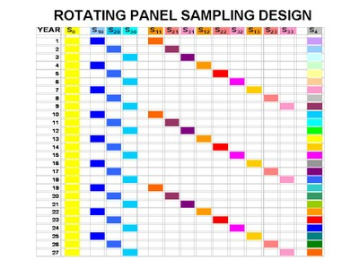
Partially augmented serially alternating
The more yearly revisits the better the site specific trend estimate (for those sites)
The more we spread out across the landscape, the better the landscape scale trend estimate (but we lose power and introduce noise)
Its really easy to build these with GRTS if you get the theory

Slide 21
How much to sample – Power Analysis
Allows us to determine the sample size required to detect an effect of a given size with a given degree of confidence. Conversely, it allows us to determine the probability of detecting an effect of a given size with a given level of confidence, under sample size constraints.
The following four quantities have an intimate relationship:
sample size (This is what we can control)
effect size (We can’t control this)
significance level = P(Type I error) = probability of finding an effect that is not there (This is a decision we make during design)
power = 1 - P(Type II error) = probability of finding an effect that is there (another decision we make)
Given any three, we can determine the fourth.

Slide 22
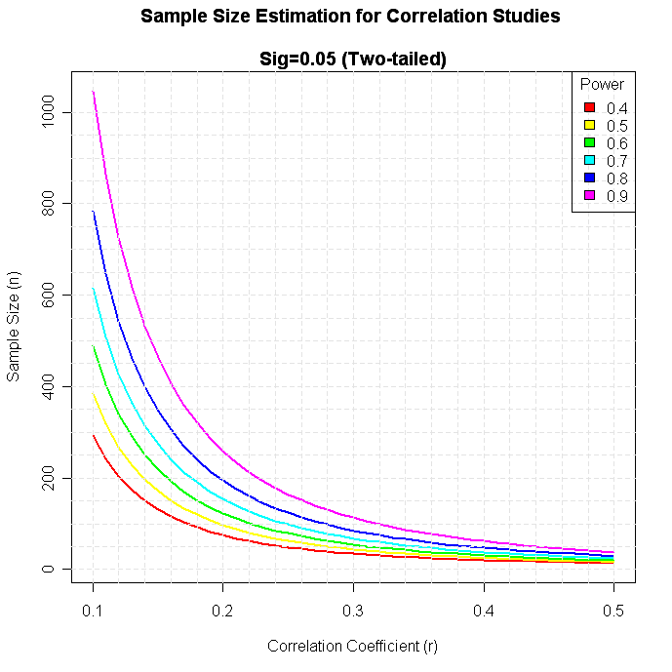
The pain of a data poor environment…
As you can see to the right, its clear that unless we have a big effect, it is hard to find for the type of sample sizes common in restoration monitoring
The take home message is to focus on relatively large changes in your design

Slide 23
A brief discussion of reference conditions
Restoration vs reference is a specialized case of a ‘paired sample’
Paired sample designs are intended to isolate the effects of an intervention from other factors that may influence the variable of interest
If we sample restoration and reference across time, we effectively have a double paired sample
A control site is one that is close to identical to our restoration site, except that no restoration has been done
Usually this is accomplished by selecting a site in physical proximity
A reference site reflects the characteristics that we want to see in our restoration sites
This can be hand selected or based on a GIS disturbance metric (e.g. road crossings)

Slide 24
Design questions?

Slide 25
Analysis

Slide 26
Analysis Section Goals
Build a reproducible analytical pipeline with the R software package.
Utilize basic QA/QC and data management processes and considerations.
Move beyond t-testing with Bayesian analysis, relative risk, and other indicators of success.
Analyze trend and control for landscape variables.
Make your data available and accessible with ESRI geo-databases and Github.
Analyze and express uncertainty in your results.

Slide 27
From the field to the computer
Getting the data from the field to the computer is a non trivial task, can be a substantial constraint in the analytical pipeline
Building a good technology interface at this stage pays big dividends –
QA/QC “on the fly” by alerting field staff to unreasonable or missing values
Data can be transferred digitally, often times immediately following data collection
Data import and pre-processing can happen almost instantaneously, often before the crew even gets back to the office
With modern smart phone and GPS technology there is no reason not to build a data entry interface

Slide 28
Things to consider in building your interface
Although in some cases you may need an expensive and integrated GPS unit (e.g. Trimble and the like) for most purposes as a monitoring professional this level of detail is unnecessary.
Ideally every interface should include the following –
Flexible constraints on what is allowed for each field
Export as a csv, txt, or other machine readable table
Geospatial integration (at least be able to drop a pin)
There are MANY options out there – I picked Fulcrum as an example
Beta test with your crew – and be prepared for complaints

Slide 29
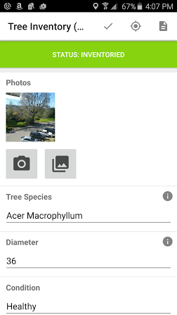
Fulcrum Example
Took less than 15 minutes to sign up and deploy a spatially enabled form
Lots of great templates
Exports as a csv
Even if you don’t have good cellular coverage, you should still take as much digital data as possible
http://www.fulcrumapp.com/

Slide 30
Building the analytical pipeline
One of the most immediate advantages to 1) taking good digital data and 2) using a code based analytical pipeline (e.g. R) is that data can be processed almost instantaneously.
This is the upside of being in a data ‘poor’ environment
You should never need to open Excel. Spreadsheets are not your friend!!!
Time required to analyze a given dataset increases ~exponentially in a spreadsheet as the dataset grows - Big O(c^n)
Time required to analyze data with code is effectively constant - Big O(c)

Slide 31
Automate and test your pipeline early
This is a two part, iterative process
First simulate data in R
This gives you a ‘stub’ to test the pipeline with
It allows you to specify the signal and the noise based on the power analysis you did in the Design phase
This helps to verify that the code does what you think it does
This also helps to validate that you have the power you think you do
Second write code to process and analyze the data
Process the data, review results, adjust and repeat as needed

Slide 32
Data preprocessing
Import the data into R from your txt or csv file
Preprocess the data –
Change names
Reorder the fields
Extract just what you need
Format into a ‘dataframe’
Although you can write out data along the way as you preprocess, this is not necessary (and in fact is less than ideal)
QA/QC your data….

Slide 33
QA/QC your data and deal with problems
Ideally you have caught most of the data entry problems at the front end by building a good interface but something always seems to slip through the cracks
If you do end up with a lot of bad or questionable data (e.g. because of lab problems) I suggest you go forward with the analysis as planned but be very cautious when presenting the results
Think very carefully about using volunteers for monitoring. I strongly discourage this for serious monitoring work (outreach and education is a different story)
QA/QC is why you need to avoid spreadsheets at all costs!

Slide 34
Dealing with missing data
Random missing values can be imputed
Non-detects can be imputed based on a distribution
R can often do this automatically for you
NA.RM = TRUE
Imputing missing data should be done with care – it can give you a false sense of security
Be sure to adjust your n value when testing later on

Slide 35
Calculate your metrics
This is what I call ‘processing’, and is probably the part most people are comfortable with
Although I’m not going to spend much time on this today, this is possibly the most useful part of using a code based pipeline
This is also an area that needs careful unit testing ahead of time
This is another HUGE advantage to using code – it is very easy to test and hard to break once testing is done

Slide 36
Weighted data and NBV
At the stage of analysis, it is essential to reweight the data points to reflect the extent of the resource (based on the sample frame)
For example, if you have ten evenly spaced sites drawn from a 100 acre sample frame, each site has a weight of 10
Weighting ensures that the estimates reflect the population
Spatially balanced sample designs with unequal design probabilities are tricky to generate variance estimates for with normal techniques (e.g. Horvitz Thompson)
Neighborhood based variance (NBV) is another tool from the EPA to account for this, and generates smaller and more accurate variance estimates (as shown with simulation)
The math for NBV gets pretty intense pretty fast here…

Slide 37
Compare populations
Depending on what you are interested in we can start with the standard classical statistical tests
T-testing, chi square, and the like for comparing two samples
ANOVA for more than two groups (and for interactions)
Data (especially with a small n) rarely clearly conforms to the assumptions of parametric methods so you should first try to transform the data, then look at non-parametric tests
Despite their prevalence, I find these to be useful primarily for exploratory purposes only
Hypothesis testing over-emphasizes sample size and under emphasizes effect. This is a big problem in a data poor environment
Always put the results of significance testing on Occam’s razor

Slide 38
Look at (and compare) trend
Linear regression is always the right place to start
Even in cases where the response is highly non-linear, if the trend is strong enough you will still see a linear trend
When including multiple regressor there is a fine line between too few and too many
Too few and you may bias your results
Too many and you may introduce unneeded variance
Dimension reduction may help identify what to include as a regressor

Slide 39
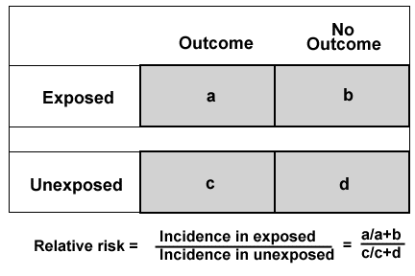
Relative Risk
Relative risk or risk ratio (RR) is the ratio of the probability of an event occurring (for example, developing a disease, being injured) in an exposed group to the probability of the event occurring in a comparison, non-exposed group.
Relative risk includes two important features: (i) a comparison of risk between two "exposures" puts risks in context, and (ii) "exposure" is ensured by having proper denominators for each group representing the exposure

Slide 40
Bayesian estimates
Bayesian estimation is a fundamentally different way of looking at data
Bayes' theorem is a way to work out the likelihood of something in the face of some particular piece, or pieces, of evidence
The theorem is usually written like this:
p(A|B) = p(B|A) p(A) / p(B)
Instead of telling us about the probability of sampling error (the frequentist p value) Bayesian estimators tells us about the probability that one thing can predict another (which is close but not equal to cause and effect)
Bayesian math also gets pretty intense pretty fast but its also really useful

Slide 41
Simple Bayesian Example
How likely is it that a stream is impaired if sediment levels are high Ie p(impairment|high sediment) or p(A|B)
We need the other half of the equation from the previous slide
p(impairment) = 10% of all streams are impaired
p(sediment) = 50% of streams have high sediment
p(sediment|impairment) = 90% of streams that are impaired have high sediment
So p(impairment|high sediment) = (0.9*0.1)/0.5 = 0.18 = 18%
This is a much better way to do inference than t-testing the sediment values for impaired vs non-impaired streams

Slide 42
Open data & reproducible research
Data should not be stuck in a report. No one reads them anyways ☺
Geodatabases are an excellent way to store raw field data in association with its geospatial component
Building your analytical pipeline in R makes it possible to reproduce the analysis exactly from the raw data
As such you do not need to store process and output files, just figures and tables
R Markdown is an easy way to blend code and text
GitHub is a free and easy to use code sharing and VCS web tool/site to which you can add your code (and data if its not too huge)

Slide 43
A story about error, dirt, and t - testing
Once upon a time a young man wanted to validate a 303(d) listing….

Slide 44
Fin

